Slide 1
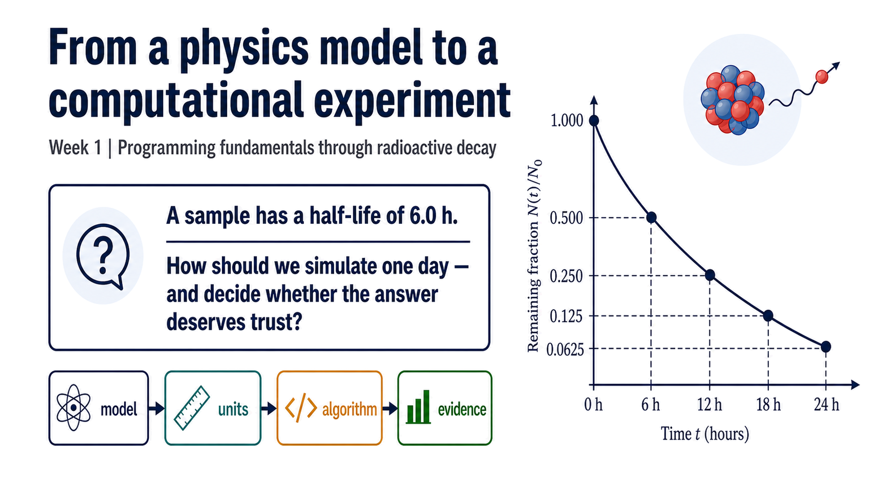
Notes:
Timing: 0–7 min Checkpoint/question: Ask students to predict the fraction remaining after one and four half-lives before showing any code. Transition: Use the question to frame the lecture arc: MATLAB is the instrument, not the physics model.

Slide 2
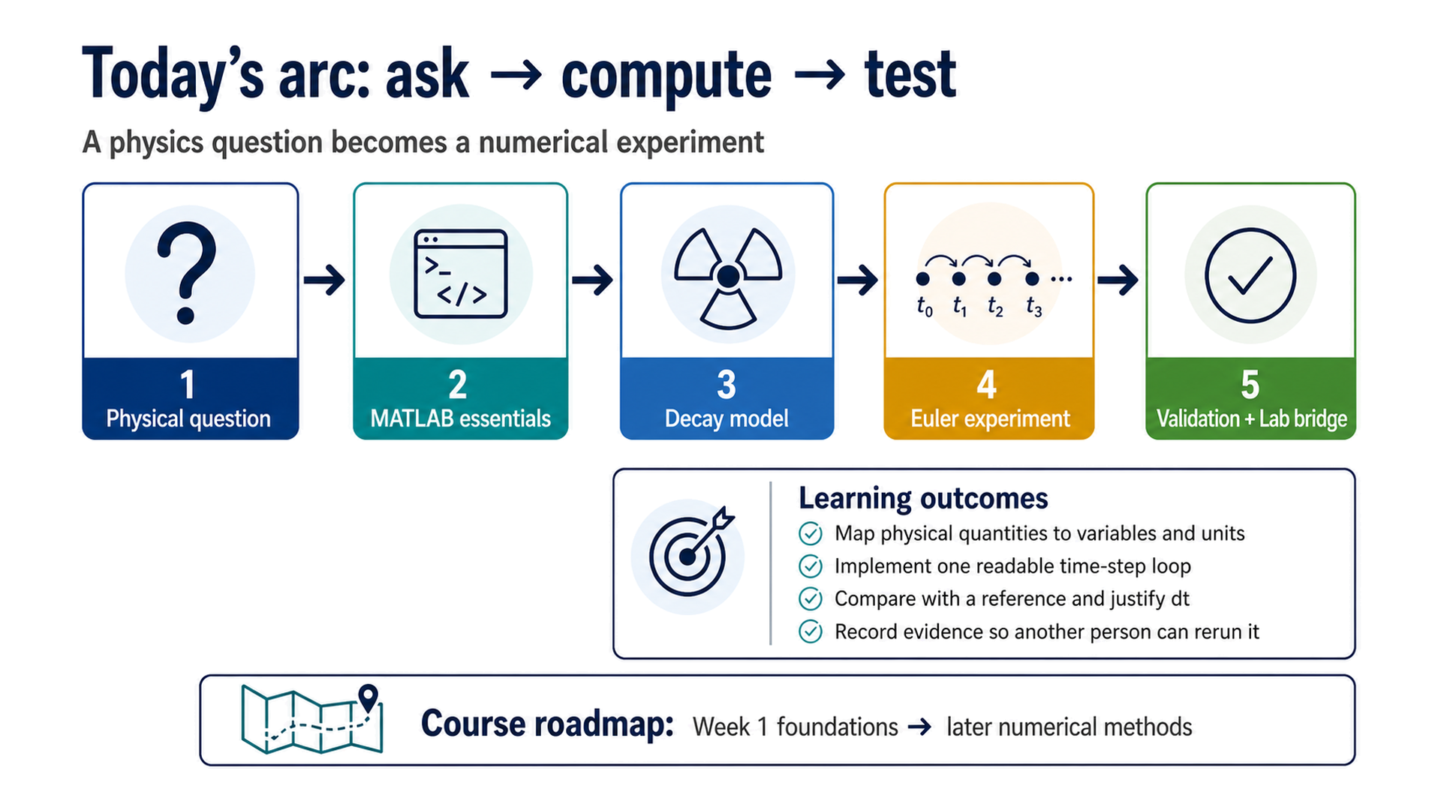
Notes:
Timing: 7–13 min Checkpoint/question: Which stage would be missing if we only showed a final plot? Transition: Make the cycle explicit before introducing the MATLAB interface.

Slide 3
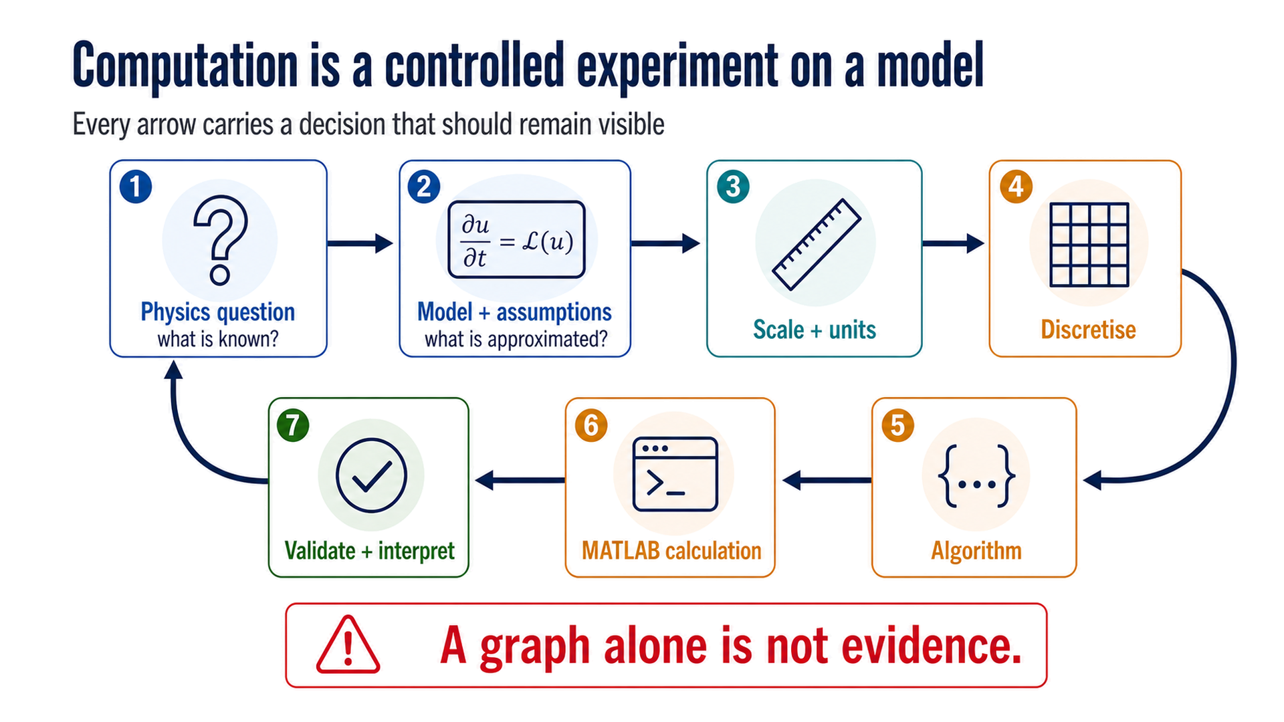
Notes:
Timing: 13–19 min Checkpoint/question: Have students name one quantity that belongs to the physical model and one that belongs to the numerical method. Transition: Now locate the minimum MATLAB views needed to carry the cycle out.

Slide 4
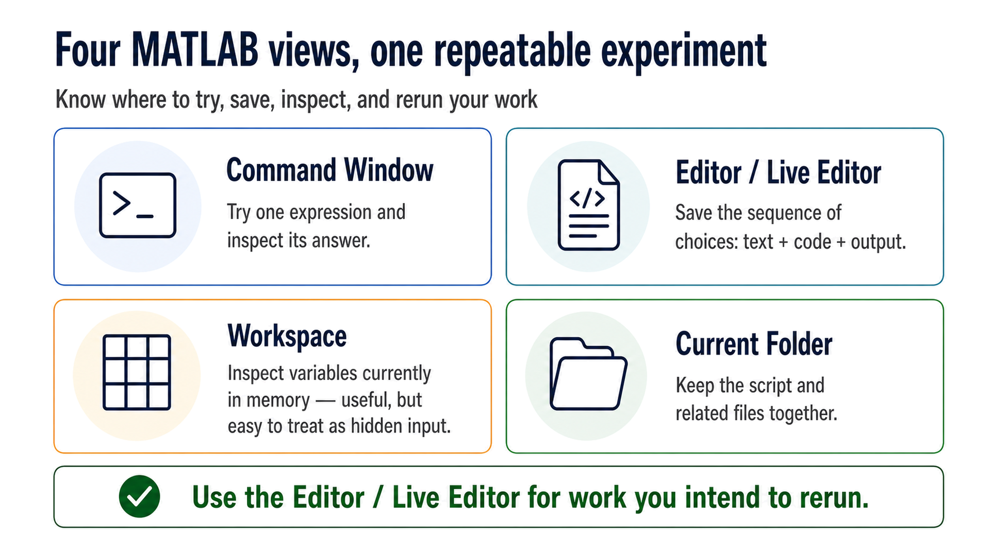
Notes:
Timing: 19–25 min Checkpoint/question: Ask: where should the experiment live if a classmate must rerun it tomorrow? Transition: The next step is naming quantities so the code carries units and assumptions with it.

Slide 5
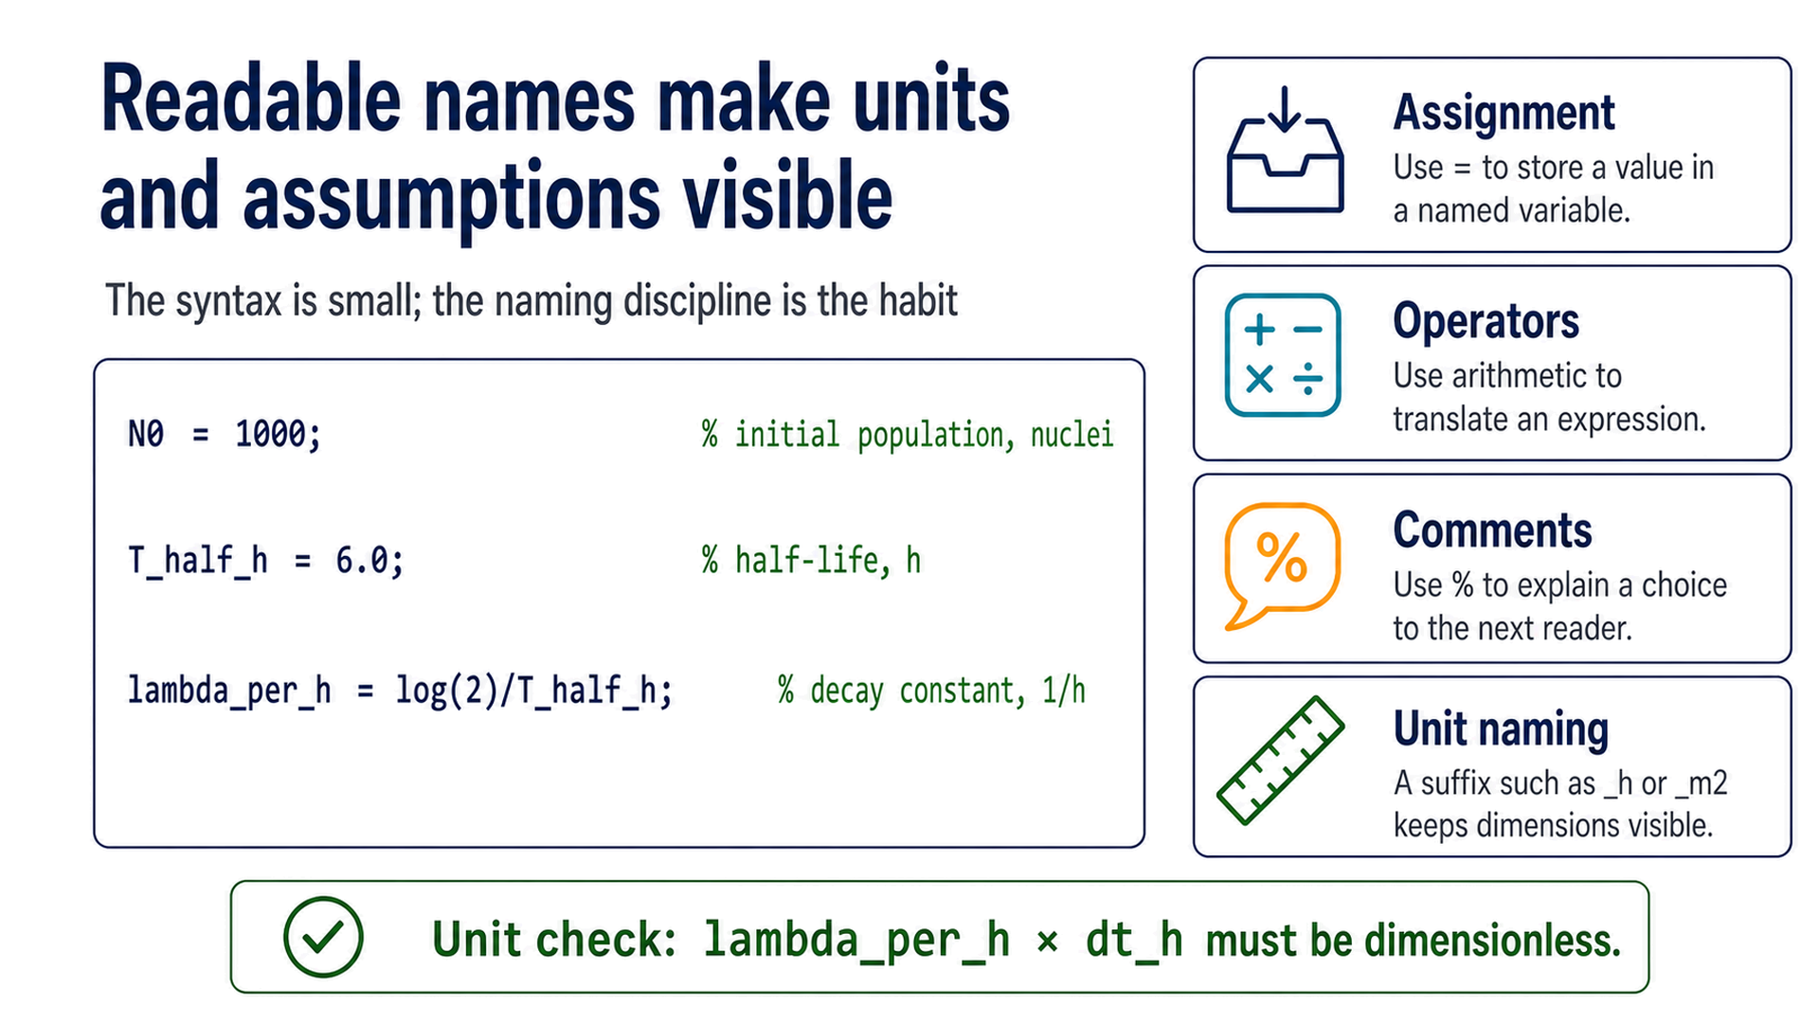
Notes:
Timing: 25–31 min Checkpoint/question: What unit does lambda_per_h carry? What unit must dt_h carry? Transition: Use the same naming habits in the physics-based Onramp diagnostic before the decay model.

Slide 6
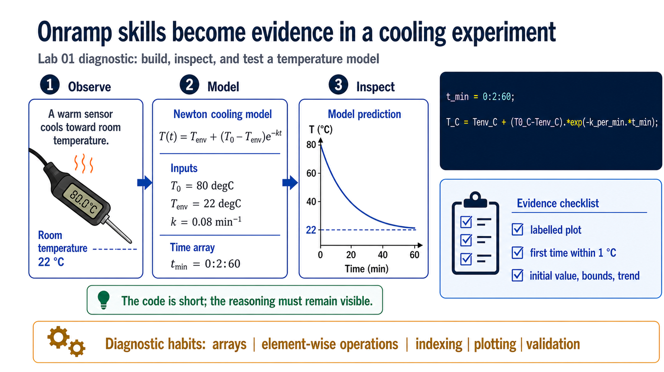
Notes:
Timing: 31–38 min Checkpoint/question: Before computing, ask students to predict the initial value, the long-time limit, and whether the model can cross below room temperature. Transition: The diagnostic uses familiar Onramp operations as evidence; the lecture now applies the same reasoning chain to radioactive decay.

Slide 7
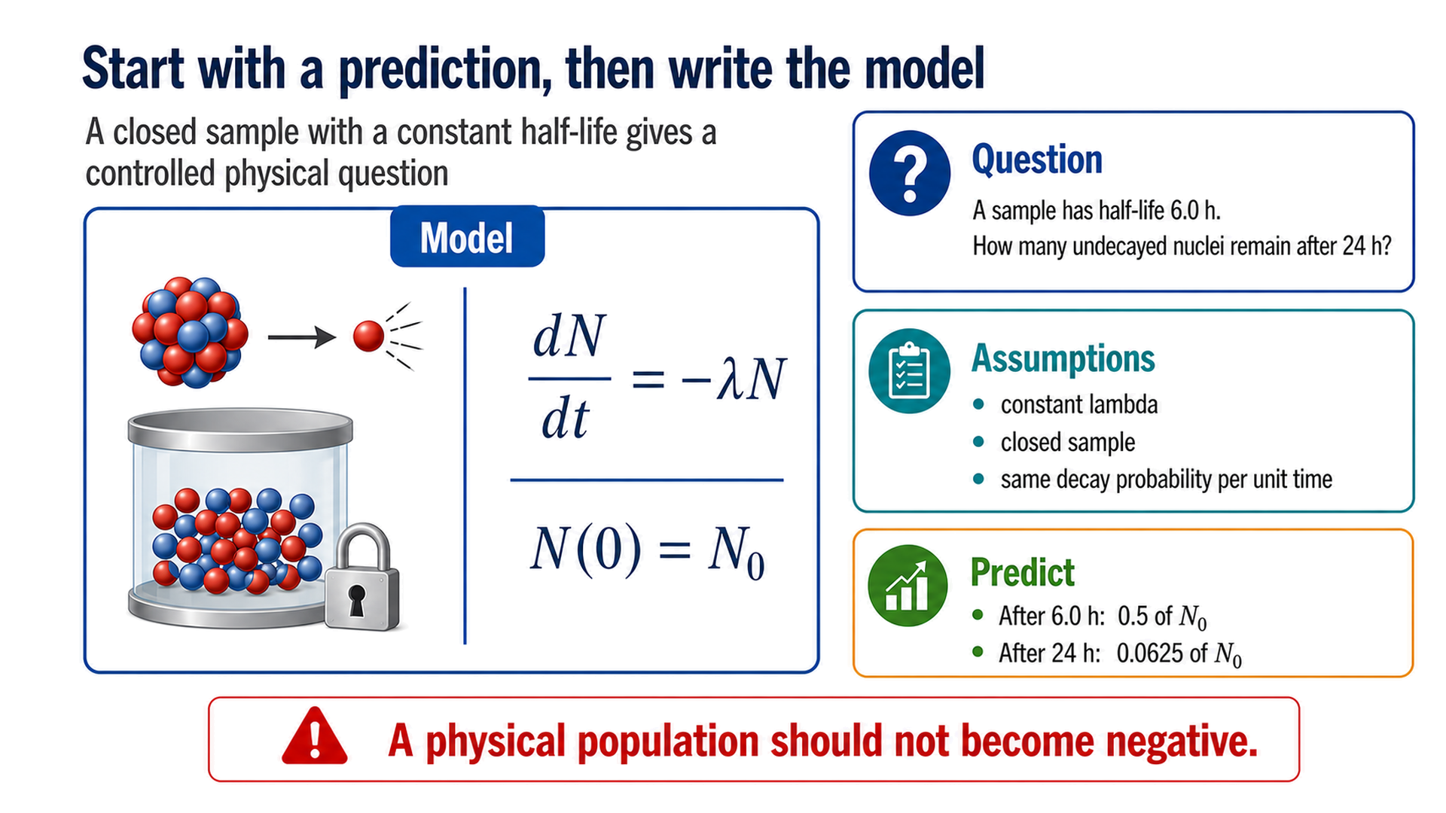
Notes:
Timing: 38–45 min Checkpoint/question: Collect predictions: what should remain after one half-life and four half-lives? Transition: Translate the symbols into names that MATLAB can store without hiding the units.

Slide 8
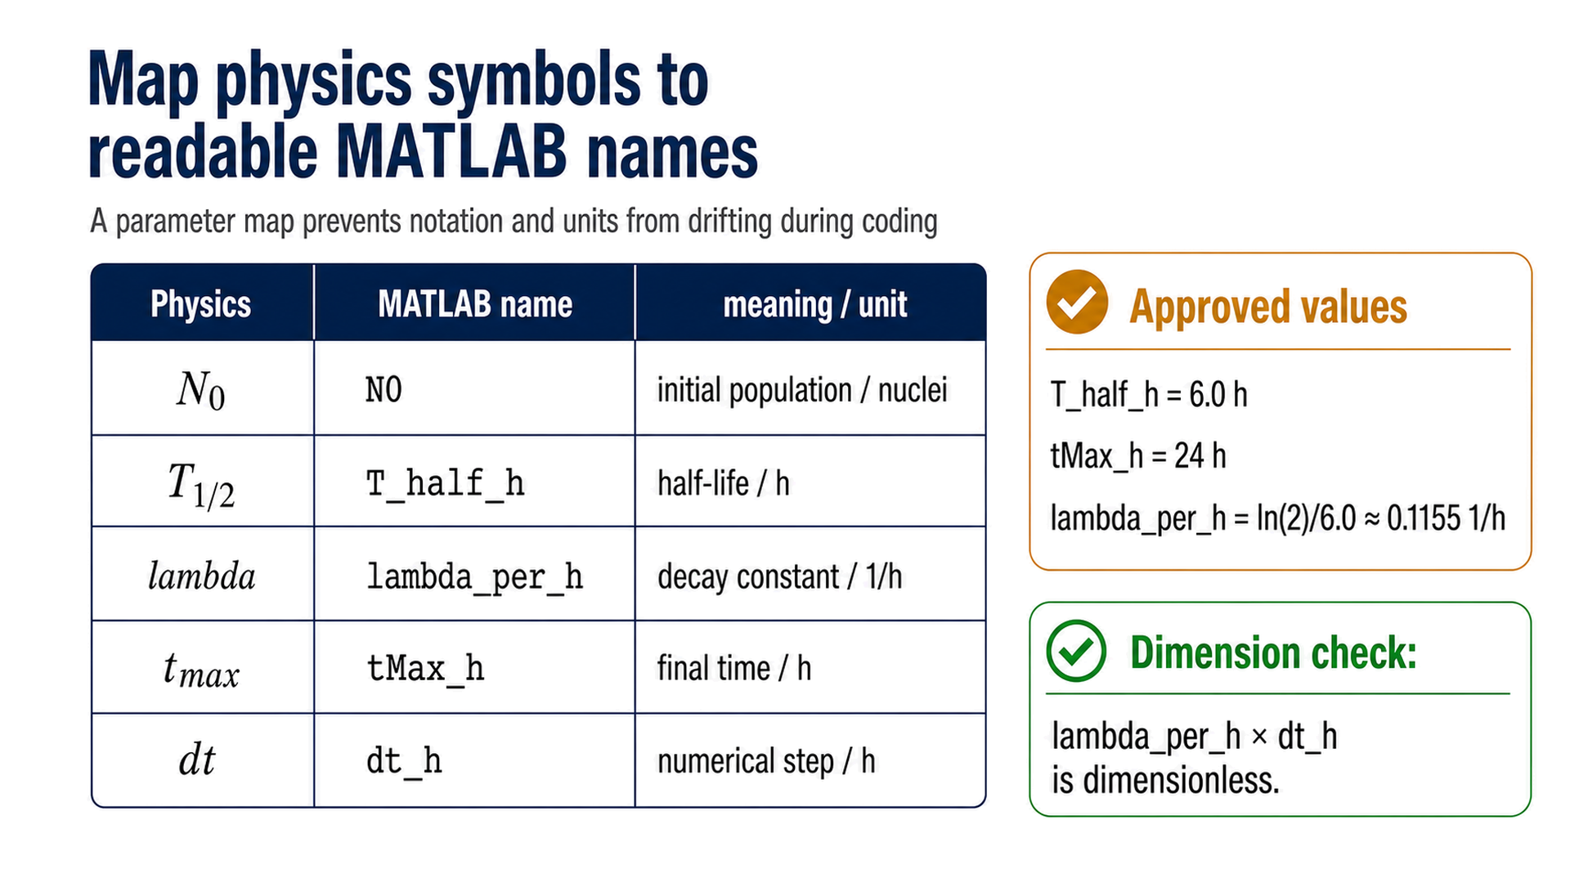
Notes:
Timing: 45–51 min Checkpoint/question: Ask students to explain why lambda_per_h and dt_h must use the same time unit. Transition: With the parameters named, construct the exact reference before approximating it.

Slide 9
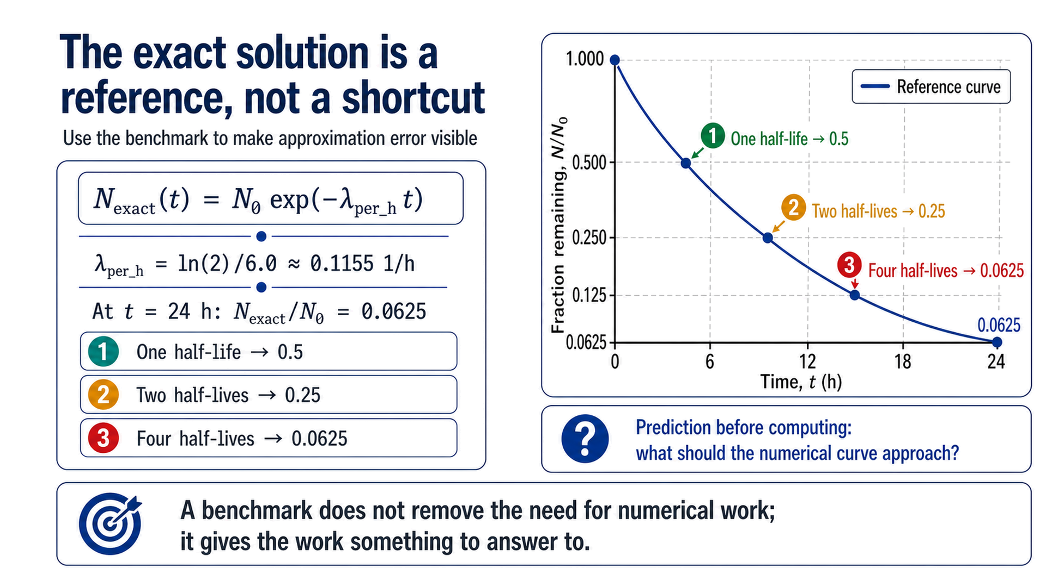
Notes:
Timing: 51–57 min Checkpoint/question: Ask students to read the reference value at 24 h and state its physical meaning. Transition: Now replace continuous time with an aligned array of discrete times.

Slide 10
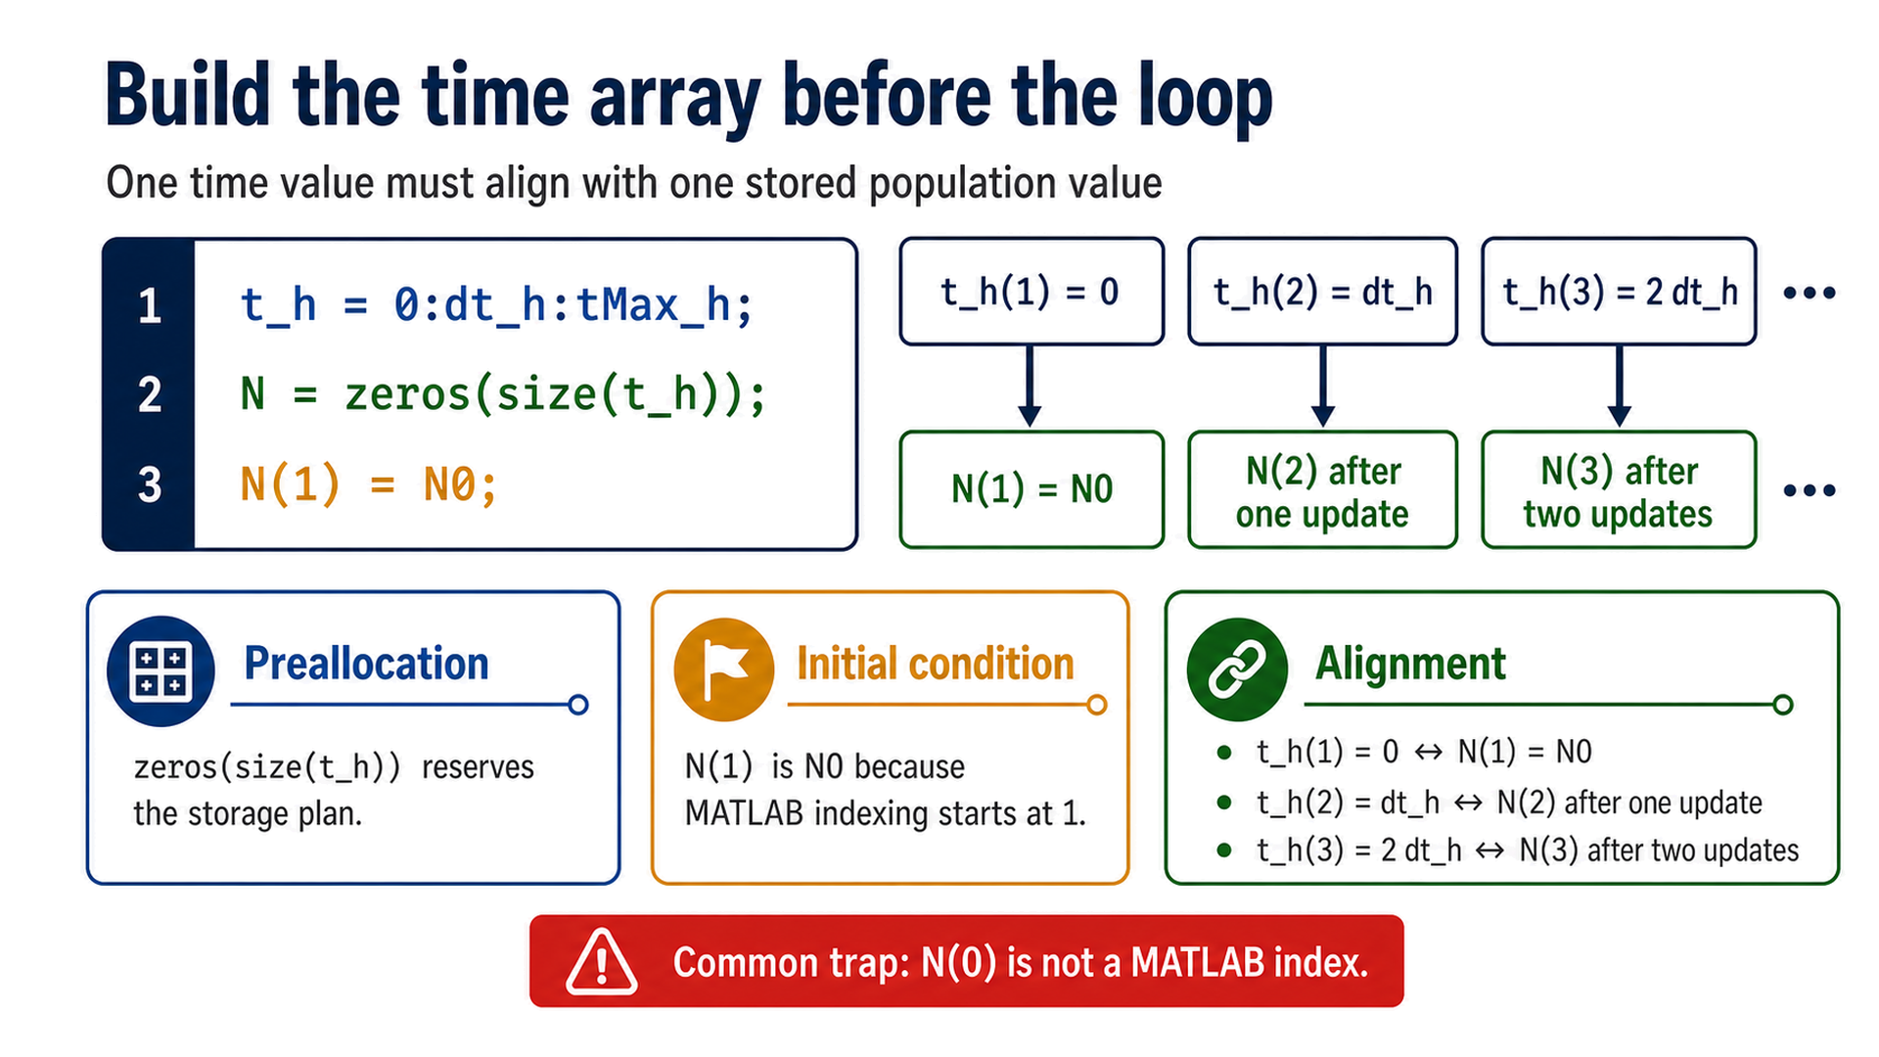
Notes:
Timing: 57–64 min Checkpoint/question: Point to the first two entries and ask which value is known before the loop runs. Transition: The derivative approximation supplies the rule that fills the next entry.

Slide 11
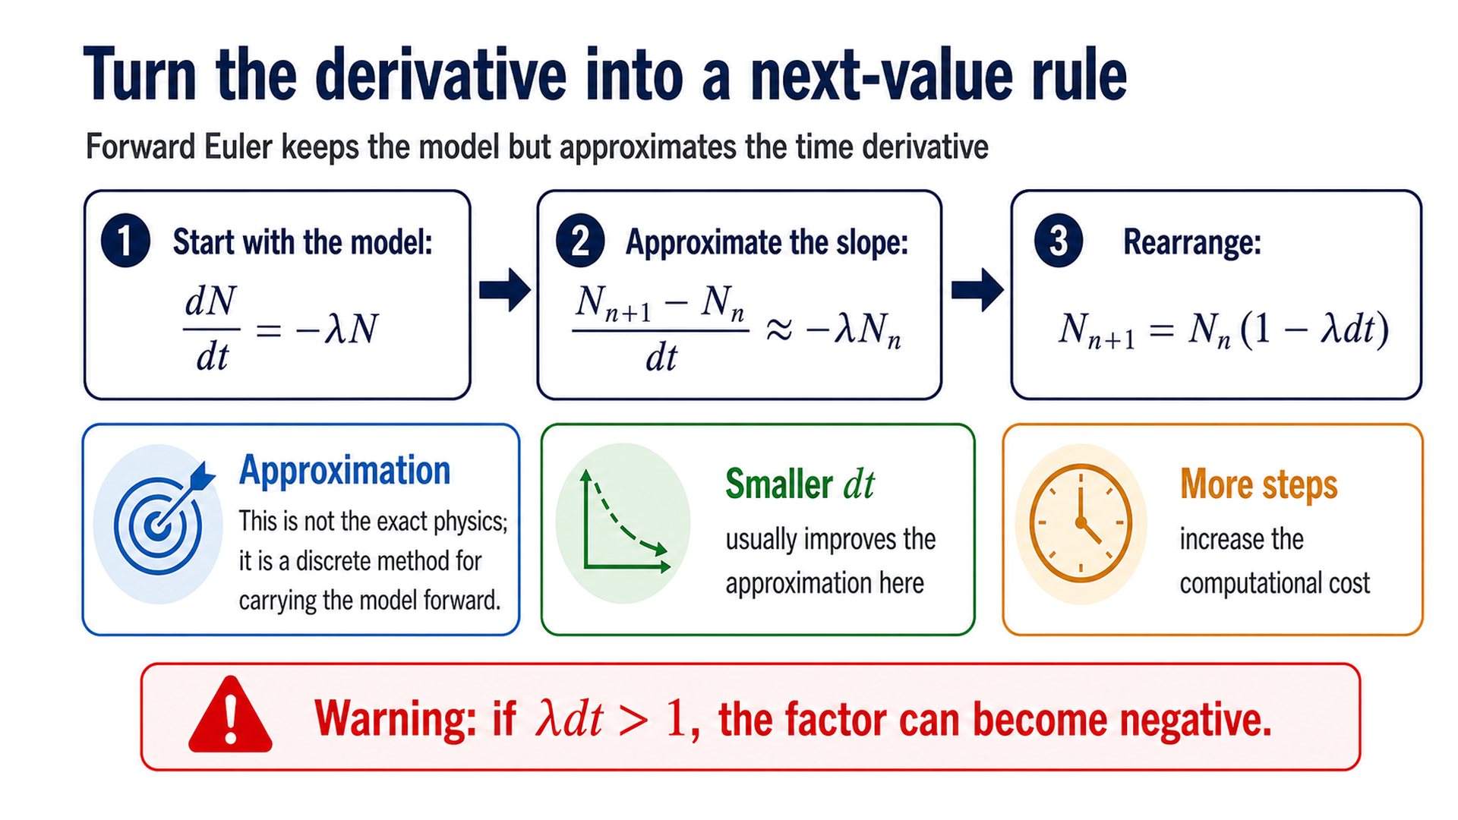
Notes:
Timing: 64–71 min Checkpoint/question: Have students identify which term must be dimensionless in the update factor. Transition: Write the same three-step logic as a minimal MATLAB loop.

Slide 12
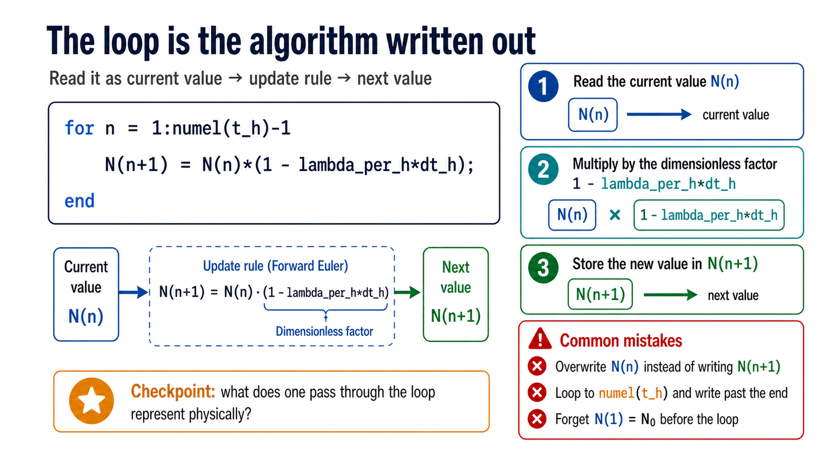
Notes:
Timing: 71–78 min Checkpoint/question: Trace one iteration on the board: which stored value is read, changed, and preserved? Transition: The code is ready; design a fair numerical experiment by changing only dt.

Slide 13
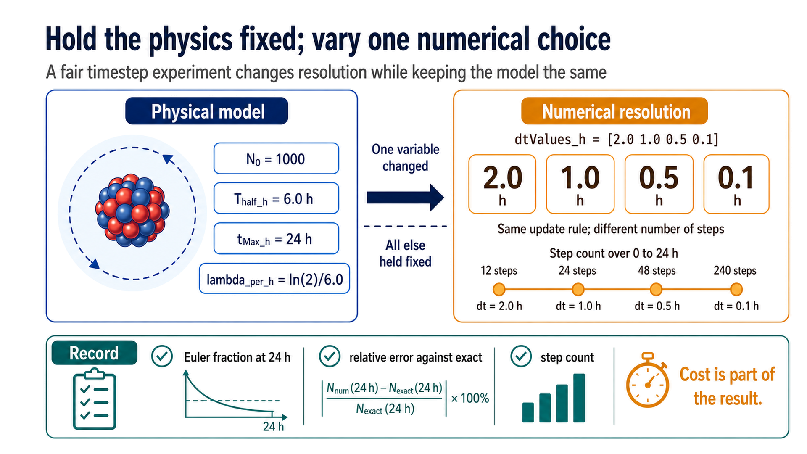
Notes:
Timing: 78–84 min Checkpoint/question: Ask which quantities must not change when comparing timesteps. Transition: Plot the four approximations against the same exact reference.

Slide 14
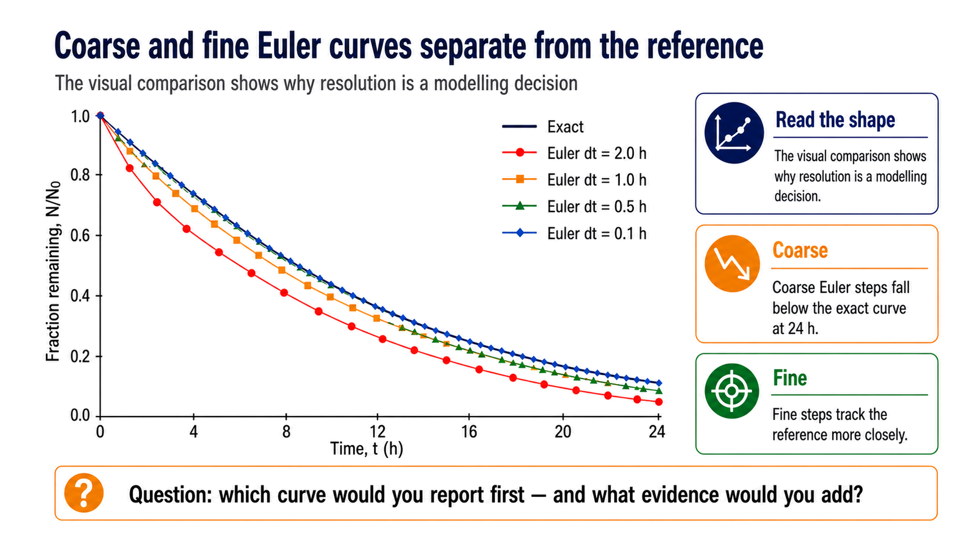
Notes:
Timing: 84–90 min Checkpoint/question: Have students rank the curves before revealing the table of final errors. Transition: Convert the visual impression into a numerical error and cost report.

Slide 15
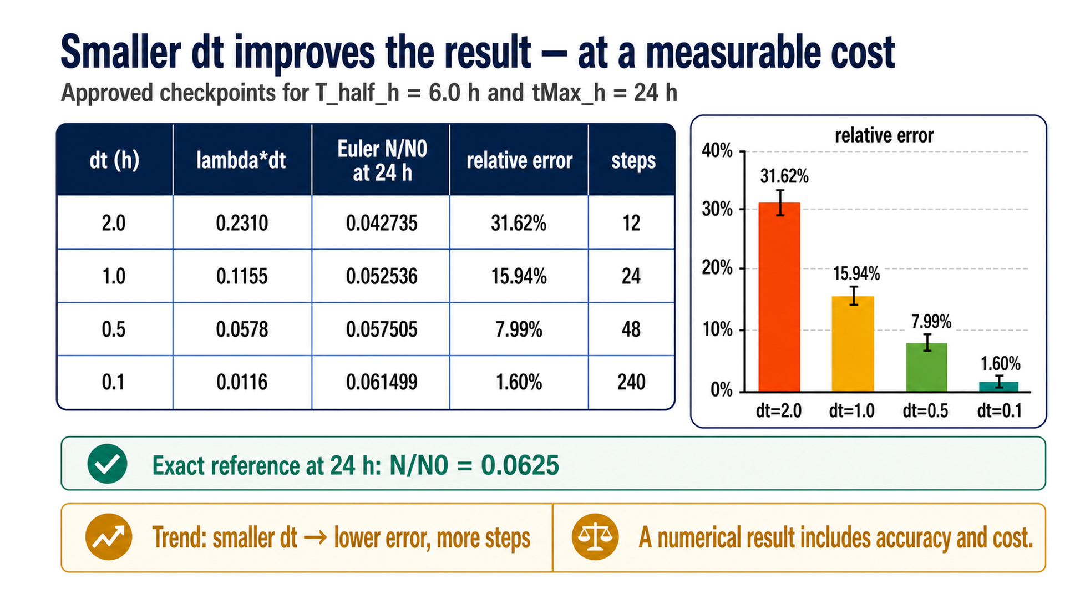
Notes:
Timing: 90–98 min Checkpoint/question: Ask students to choose a timestep for a first report and defend it using error plus cost. Transition: A trustworthy report also needs checks on physics, units, implementation, and communication.

Slide 16
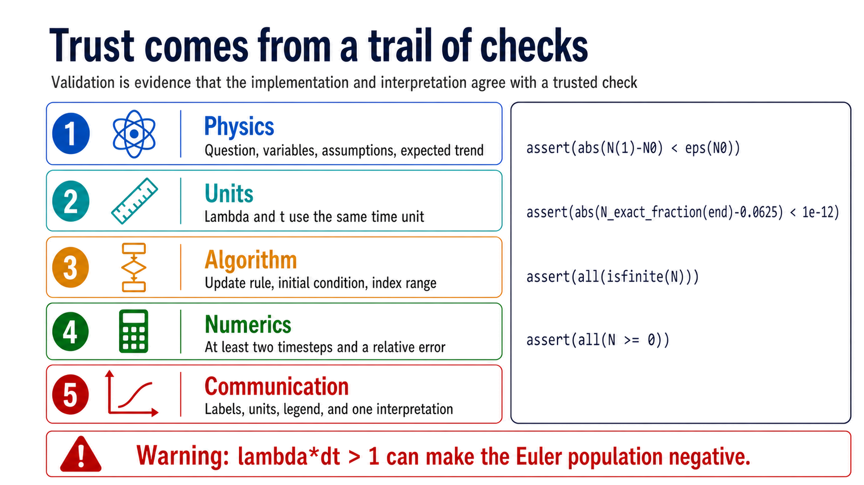
Notes:
Timing: 98–105 min Checkpoint/question: Which assertion would catch a missing initial condition? Which would catch a nonphysical negative population? Transition: Checks make the result defensible; reproducibility makes the checks portable to another person and another day.

Slide 17
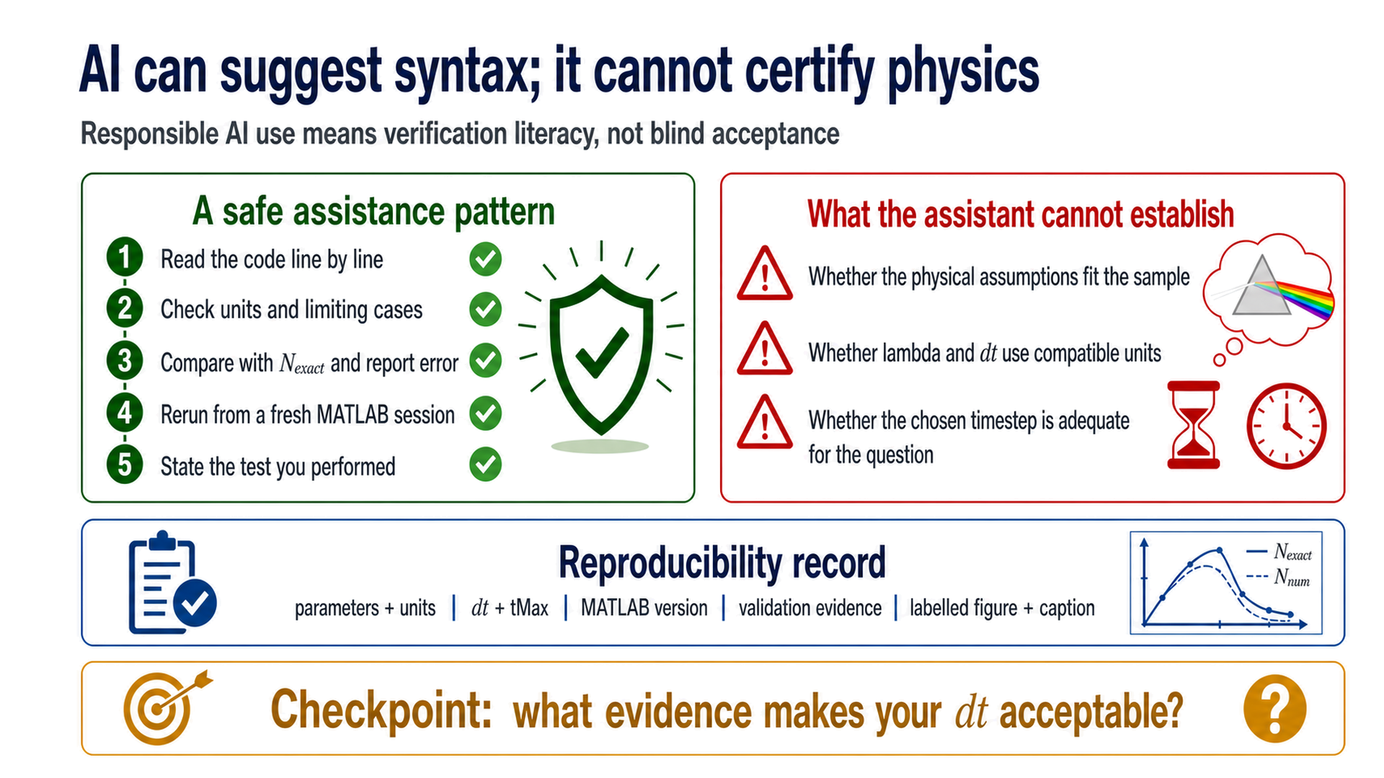
Notes:
Timing: 105–112 min Checkpoint/question: Invite one student example of a test that an AI-generated answer would not perform automatically. Transition: Close by turning the full cycle into a practical handoff and exit ticket.

Slide 18
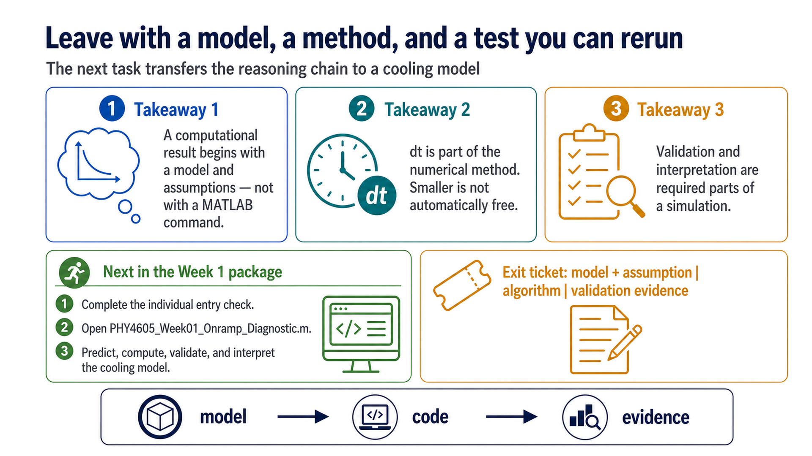
Notes:
Timing: 112–120 min Checkpoint/question: Collect the three-sentence exit ticket before students leave. Transition: End with the practical handoff: complete the entry check, then transfer the reasoning chain to the cooling-model Onramp diagnostic.

